Slide 1
FullStack
Ecommerce
Website
{
< Presented to: Dr. Dina, Eng. Verina Nashaat >
< Internet Programming - CSE341 >
}
...

Slide 2
Team Members
{
Student | ID
Patrick Ramez Eskander | 21P0180
Monica Hany Makram | 21P0173
Mohamed Hossam Abdelalim | 21P0254
Youssef Hany Emil | 21P0082
Mark Saleh Sobhi | 21P0206
Youssef Adel Albert | 21P0258
Ahmed Tarek Mahmoud | 2100561
}

Slide 3
Table of contents
01
02
03
Project Overview
What does the website do ?
Functional Requirements
Explaining all the requirements needed
Technology used
Explaining all the tech used for building the website
Notes:
Functional Requirements (High-level)
Group into:
User-side: Registration, cart, checkout, search, profile
Admin-side: Inventory, orders, promotions
Highlight 2 functions (as requested):
Add-to-Cart & Checkout Flow
Admin Product Management

Slide 4
Table of contents
04
05
06
Code snippets
What does the code do ?
...
...
Conclusion
Wrap things up

Slide 5
01
Project
Overview
{
..
}
..

Slide 6
Project Overview!
}
Objective: Build a secure, responsive, full-stack e-commerce app.
Scope: Authentication, product catalog, cart, checkout, and order management.
Stakeholders:
Users (buyers)
Admins (product & order managers)
Developers (us)
*

Slide 7
02
Functional
Requirements
{
..
}
..

Slide 8
Functional Requirements
User side | Registration, cart, checkout, search, profile
Admin side | Inventory, orders, promotions
Highlight functions (as requested):
Checkout Flow
Add-to-Cart
Refund Admin product management
Notes:
Functional Requirements (High-level)
Group into:
User-side: Registration, cart, checkout, search, profile
Admin-side: Inventory, orders, promotions
Highlight 2 functions (as requested):
Add-to-Cart & Checkout Flow
Admin Product Management

Slide 9
03
Technology
Used
{
..
}
..

Slide 10
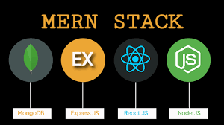
Technology Used

Slide 11
M – MongoDB
< The Database >
NoSQL document-oriented database.
1
3
Used for storing product info, users, orders, etc.
4
Works great with JavaScript via native BSON format.
2
Stores data as flexible JSON-like documents.

Slide 12
E – Express.js
< The Server >
Lightweight Node.js framework for building web APIs.
1
3
Middleware-based: easy to plug in authentication, validation, etc.
4
Acts as the bridge between frontend and database.
2
Handles HTTP requests like GET /products or POST /login

Slide 13
R & N – React.js & Node.js
< Frontend and Runtime >
js builds the dynamic frontend UI (product listings, cart, forms).
1
3
Node.js powers the backend and runs Express
4
Allows using JavaScript on both frontend and backend.
2
Uses components and hooks to manage user interaction

Slide 14
Technical Requirements
Prioritized Features
Feature | Priority | Status
User Auth (JWT, bcrypt) | Must | ✅ Done
Product/Cart/Checkout Flow | Must | ✅ Done
Stripe Payment Integration | Must | ✅ Done
Admin Management | Must | ✅ Done
Profile Management | Should | ✅ Done
Product Reviews | Should | ✅ Done
Discount/Coupons | Should | ✅ Done
Sales Chart & Analytics | Could | ⏳ Planned
Cancell order (Confirmed or pending) | Could | ✅ Done

Slide 15
Backend
Development Tools & Libraries
🔐 1. JWT Authentication Flow
How it works:
On login or signup, the server issues a JWT containing user data.
The client stores the token (usually as an HTTP-only cookie).
Protected routes validate the token using a middleware.
// login.controller.ts
const token = createToken(user); // JWT creation
res.setHeader('Set-Cookie', [createCookie(token)]);
res.json({ user, token: token.token });
// auth.middleware.ts
const token = req.cookies['Authorization'] || extractBearerToken(req);
const payload = verify(token, SECRET_KEY); // JWT validation
req.user = await UserModel.findById(payload._id);

Slide 16
Backend
Development Tools & Libraries
🛡 2. Middleware for Security & Validation
Middleware Types:
auth.middleware.ts – verifies JWT
authRequired.middleware.ts – blocks unauthenticated users
validation.middleware.ts – checks request body using
class-validator
error.middleware.ts – global error handler
// Example: Protected route with role-based access
router.post(
'/coupons',
authMiddleware,
adminOnlyMiddleware,
validationMiddleware(CreateCouponDto, 'body'),
couponController.createCoupon
);

Slide 17
Backend
Development Tools & Libraries
🔒 3. Password Hashing with bcrypt
Passwords are not stored as text
// signup
const hashed = await hash(password, 10);
await UserModel.create({ ...data, password: hashed });
// login
const user = await UserModel.findOne({ email }).select('+password');
const match = await compare(password, user.password);

Slide 18
Backend
Development Tools & Libraries
📦 4. API Structure & Routing
RESTful Structure:
CRUD Example:
server/
├─ controllers/ (e.g. user.controller.ts)
├─ services/ (e.g. auth.service.ts)
├─ routes/ (e.g. user.route.ts)
├─ models/ (e.g. user.model.ts)
├─ middlewares/ (auth, validation, error)
POST /api/products -> createProduct()
GET /api/products -> listProducts()
PUT /api/products/:id -> updateProduct()
DEL /api/products/:id -> deleteProduct()

Slide 19
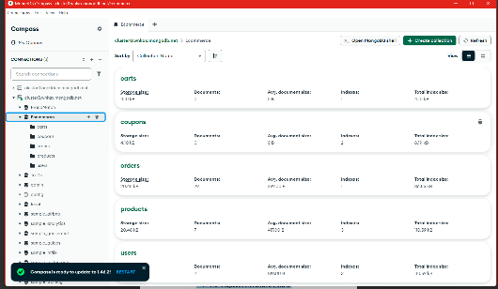
Backend
Development Tools & Libraries
🌐 5. External Integrations
1. Stripe
Used for payment processing via secure checkout session.
Handles redirection, payment success/failure, and backend webhook events.
2. MongoDB (via Mongoose)
Main data store for users, products, orders, etc.
3. (Optional) Image Hosting
Products use imageUrl field — implies either hosted images or planned image uploads.
const session = await stripe.checkout.sessions.create({
line_items, success_url, cancel_url, metadata: { orderId }
});

Slide 20
04
Code
Snippets
{
..
}
..

Slide 21
Functional Requirements (High-level)
{
User-side
Admin-side
Registration, cart, checkout, search, profile
Inventory, orders, promotions
}
*

Slide 22
User Side
{
..
}
..

Slide 23

<Frontend>
Notes:
Frontend Architecture
Stack: HTML, CSS, JavaScript
CSS Framework: Bootstrap
Client-side logic using Vanilla JS (or React if applicable)
Interaction with backend APIs (fetch/Axios)

Slide 24
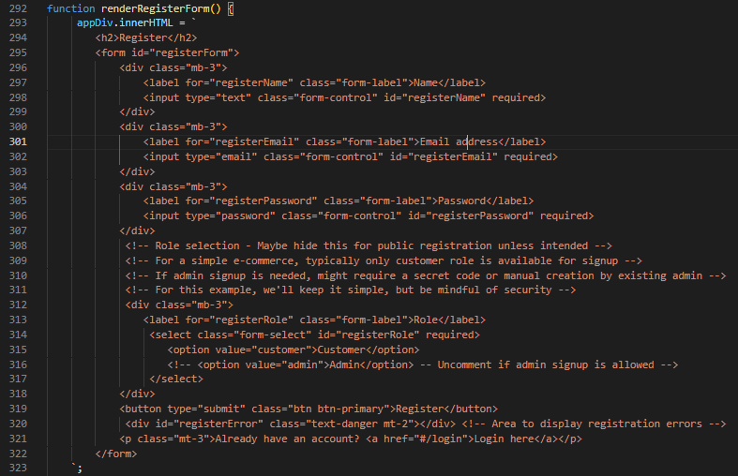
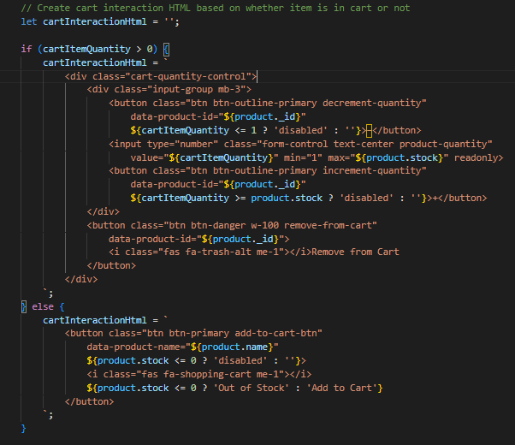
Registeration
Cart
}
...
Notes:
Demo / Screenshots
Optional short video/GIF walkthrough
Emphasize:
Login/Register
Product interaction
Cart & checkout
Admin product management

Slide 25
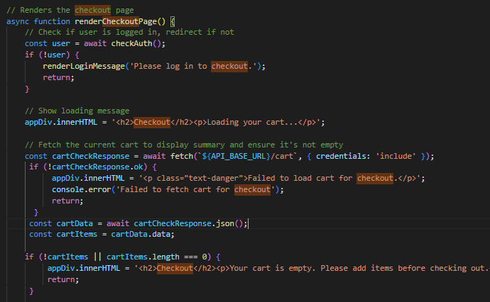
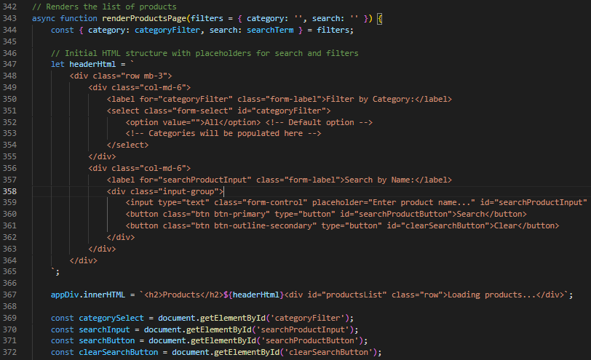
Checkout
Search
}
...
Notes:
Demo / Screenshots
Optional short video/GIF walkthrough
Emphasize:
Login/Register
Product interaction
Cart & checkout
Admin product management

Slide 26
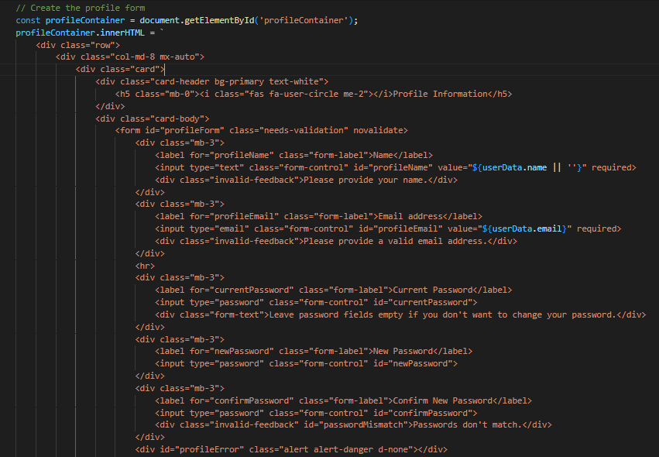
Profile
}
...
Notes:
Demo / Screenshots
Optional short video/GIF walkthrough
Emphasize:
Login/Register
Product interaction
Cart & checkout
Admin product management

Slide 27
Admin Side
{
..
}
..

Slide 28
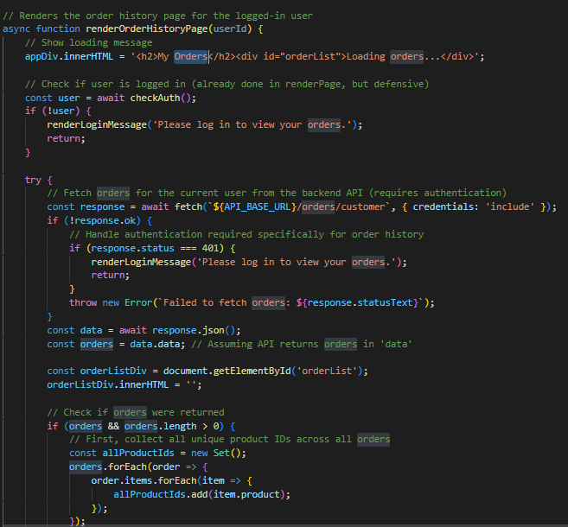
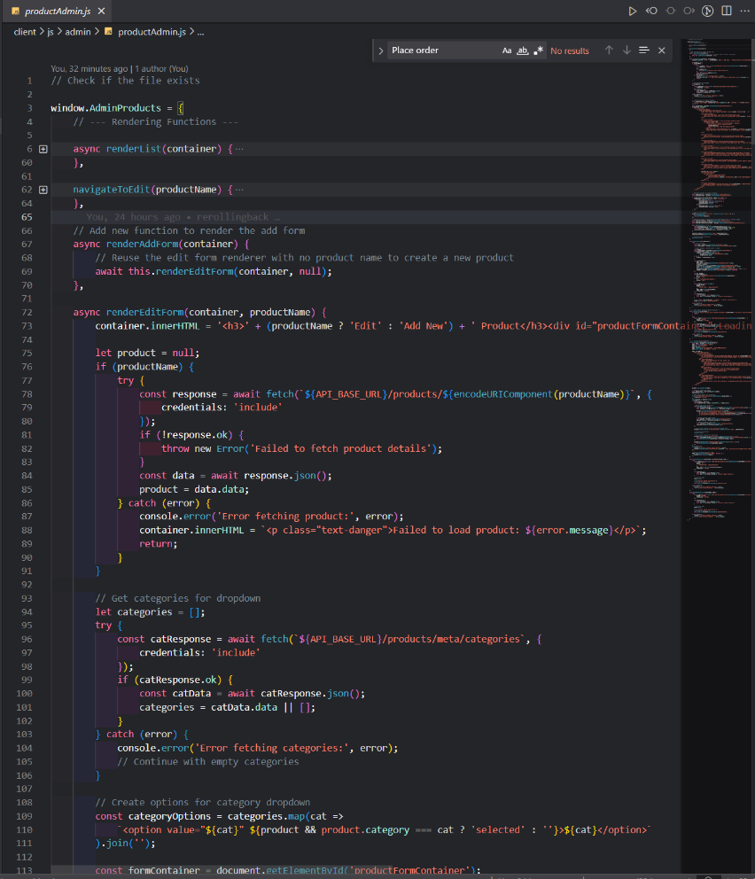
Orders
Product
}
...
Notes:
Demo / Screenshots
Optional short video/GIF walkthrough
Emphasize:
Login/Register
Product interaction
Cart & checkout
Admin product management

Slide 29
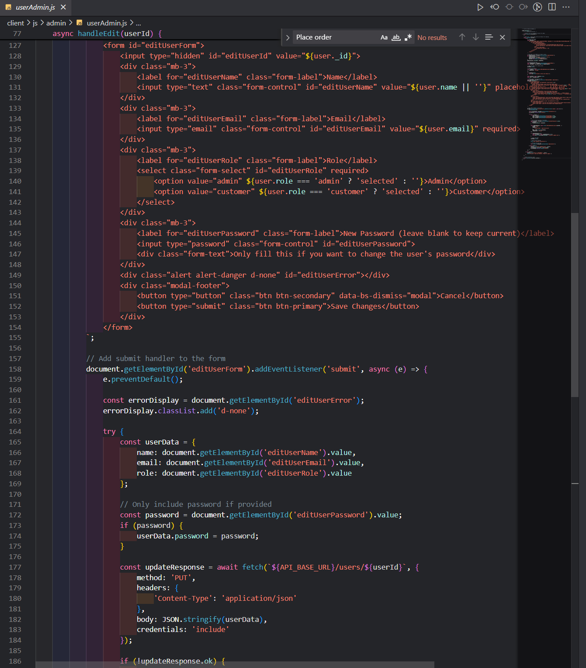
User admin
}
...
Notes:
Demo / Screenshots
Optional short video/GIF walkthrough
Emphasize:
Login/Register
Product interaction
Cart & checkout
Admin product management

Slide 30
Core pages walkthrough
{
}
Notes:
Core Pages Walkthrough
Home Page: Product display, responsive grid
Product Page: Details, add to cart
Cart Page: Item summary + Checkout button
Checkout Page: Form + payment summary
Admin Dashboard (optional): Manage orders/products

Slide 31
<Backend>

Slide 32
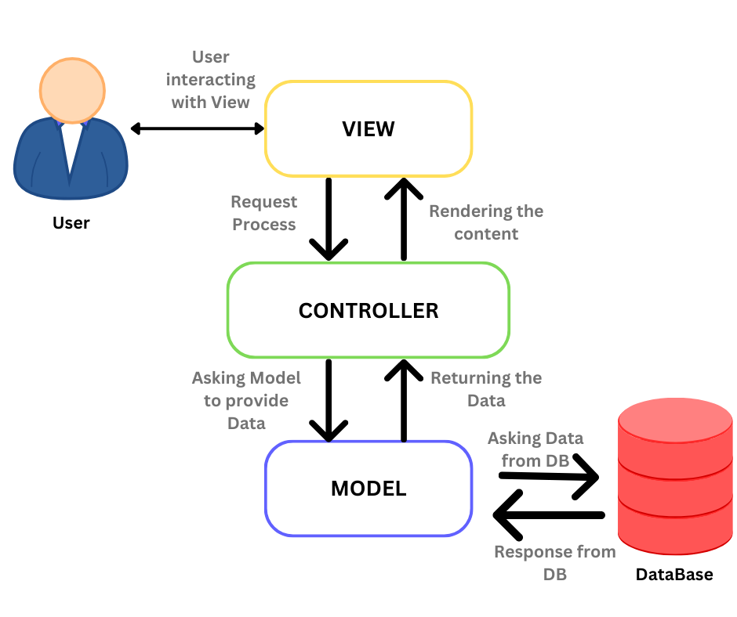
MVC
{
..
}
..

Slide 33
Authentication
{
}
Notes:
Core Pages Walkthrough
Home Page: Product display, responsive grid
Product Page: Details, add to cart
Cart Page: Item summary + Checkout button
Checkout Page: Form + payment summary
Admin Dashboard (optional): Manage orders/products

Slide 34
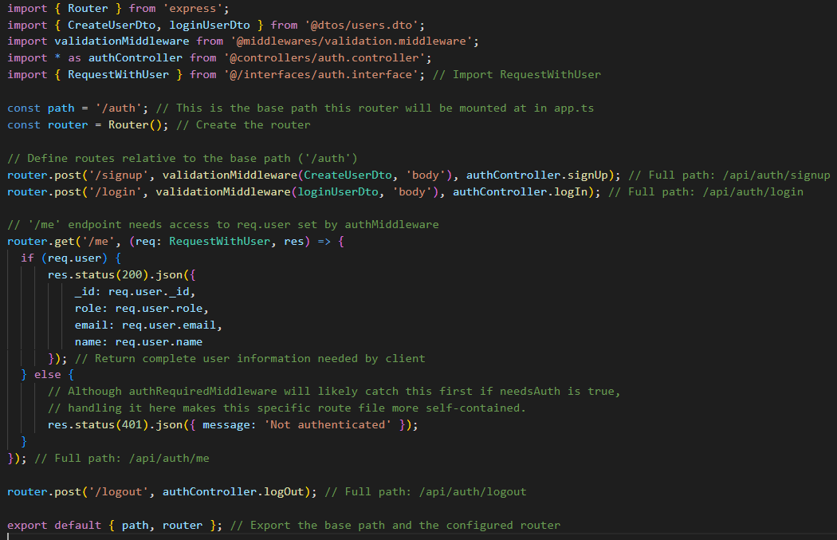
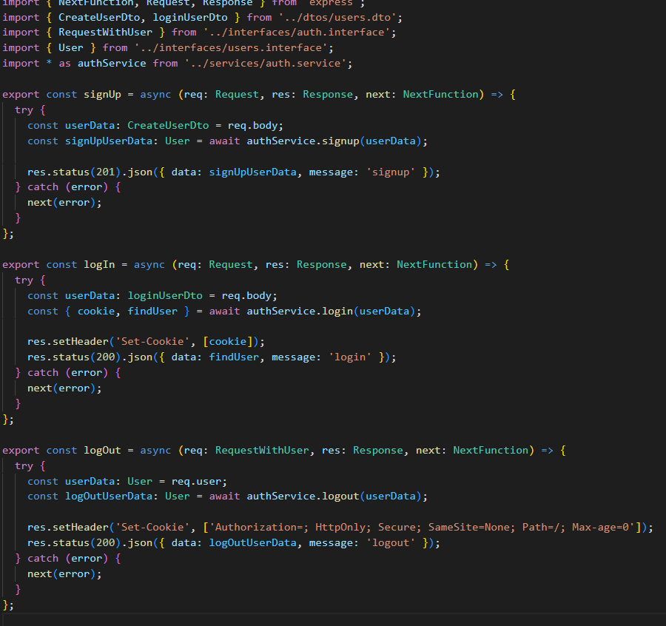
Auth.route.ts
Auth.controller.ts
}
...
Notes:
Demo / Screenshots
Optional short video/GIF walkthrough
Emphasize:
Login/Register
Product interaction
Cart & checkout
Admin product management

Slide 35
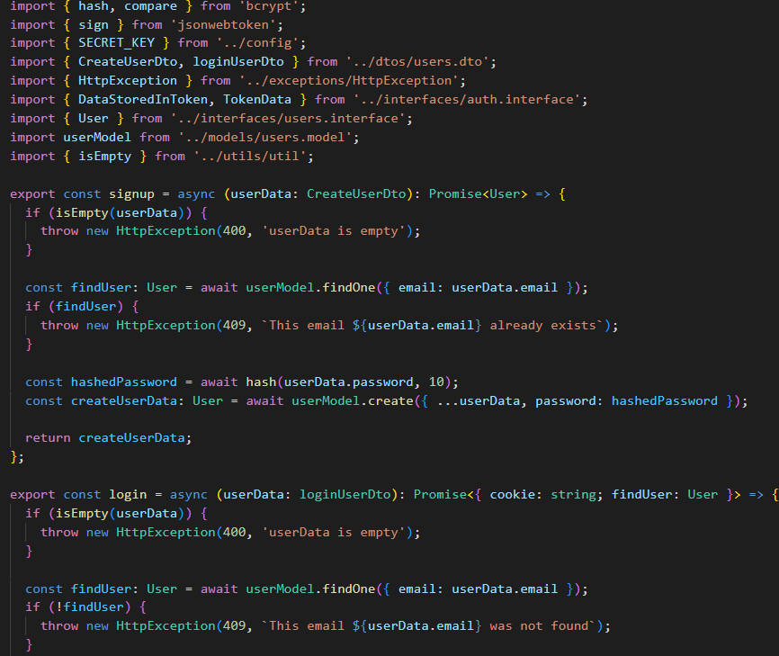
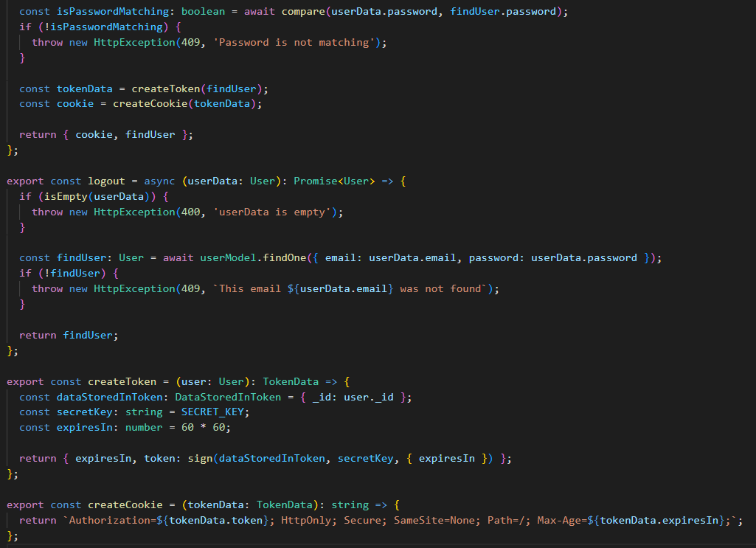
Auth.service.ts
}
...
Notes:
Demo / Screenshots
Optional short video/GIF walkthrough
Emphasize:
Login/Register
Product interaction
Cart & checkout
Admin product management

Slide 36
Cart
{
}
Notes:
Core Pages Walkthrough
Home Page: Product display, responsive grid
Product Page: Details, add to cart
Cart Page: Item summary + Checkout button
Checkout Page: Form + payment summary
Admin Dashboard (optional): Manage orders/products

Slide 37
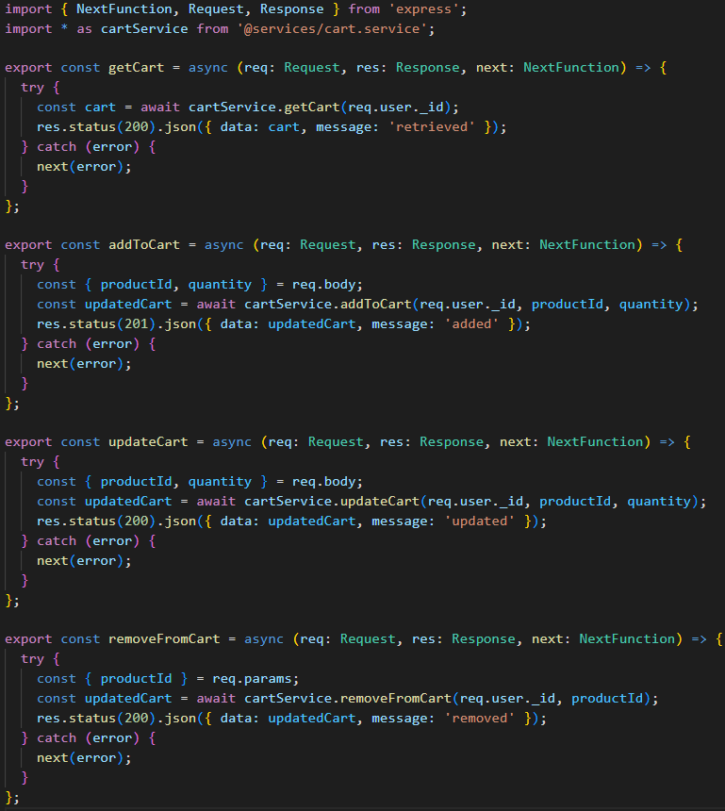
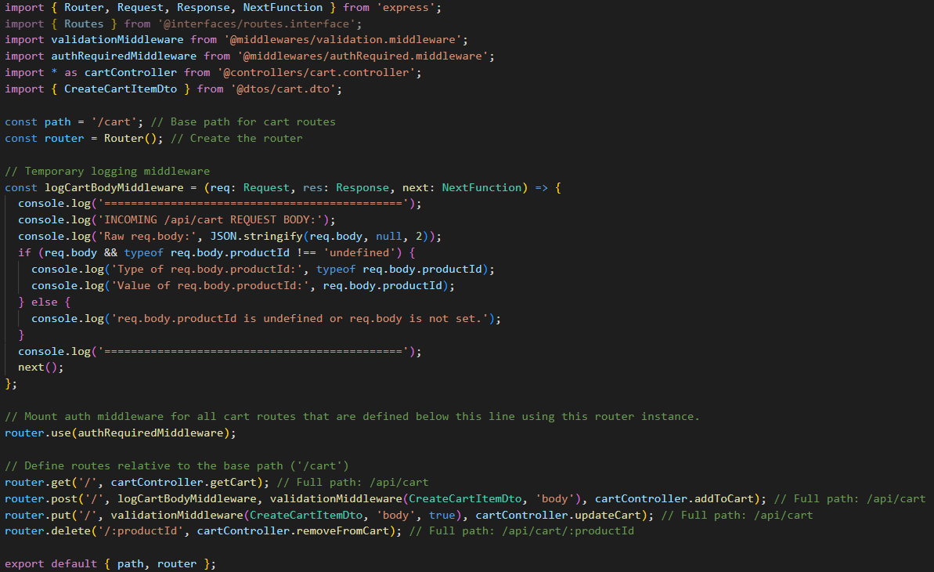
Cart.route.ts
Cart.controller.ts
}
...
Notes:
Demo / Screenshots
Optional short video/GIF walkthrough
Emphasize:
Login/Register
Product interaction
Cart & checkout
Admin product management

Slide 38
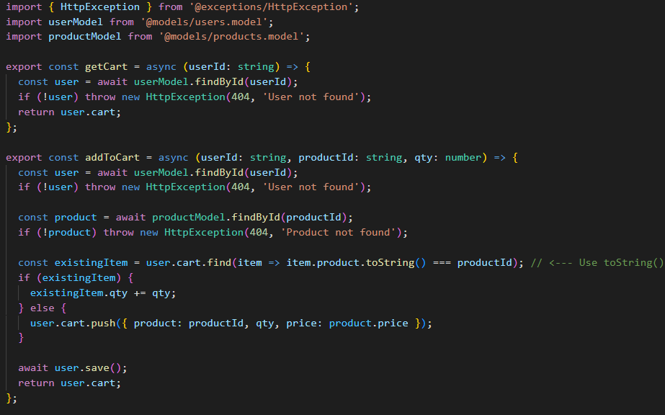
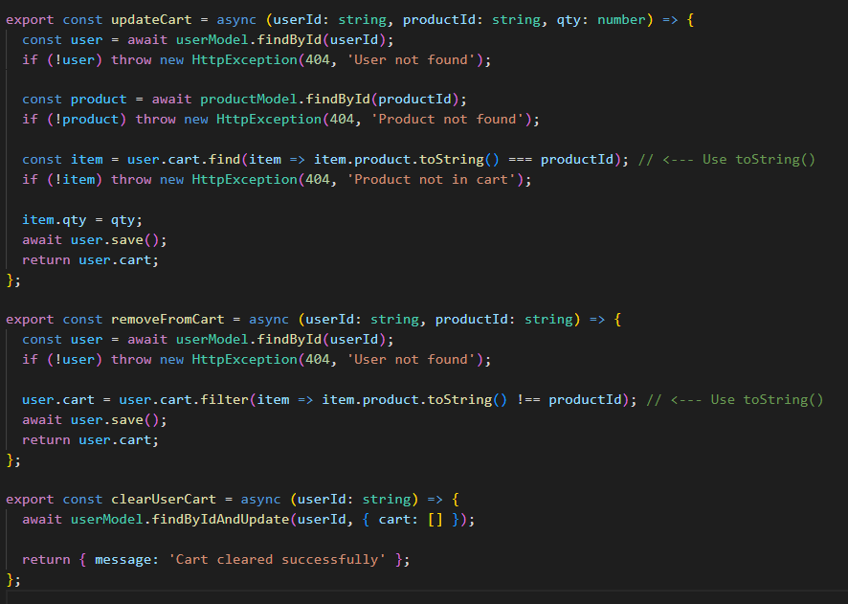
Cart.service.ts
}
...
Notes:
Demo / Screenshots
Optional short video/GIF walkthrough
Emphasize:
Login/Register
Product interaction
Cart & checkout
Admin product management

Slide 39
Order
{
}
Notes:
Core Pages Walkthrough
Home Page: Product display, responsive grid
Product Page: Details, add to cart
Cart Page: Item summary + Checkout button
Checkout Page: Form + payment summary
Admin Dashboard (optional): Manage orders/products

Slide 40
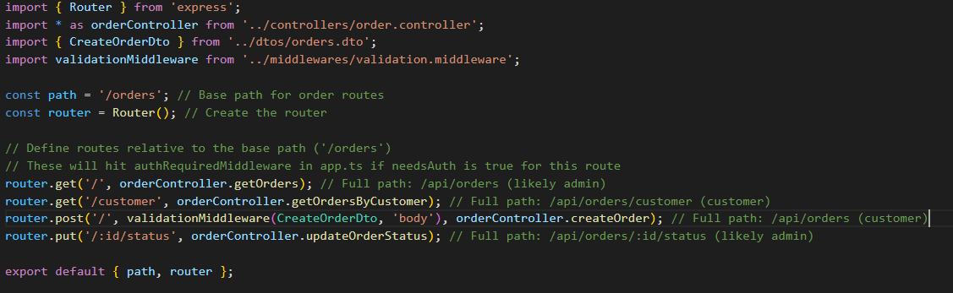
Order.route.ts
}
...
Notes:
Demo / Screenshots
Optional short video/GIF walkthrough
Emphasize:
Login/Register
Product interaction
Cart & checkout
Admin product management

Slide 41
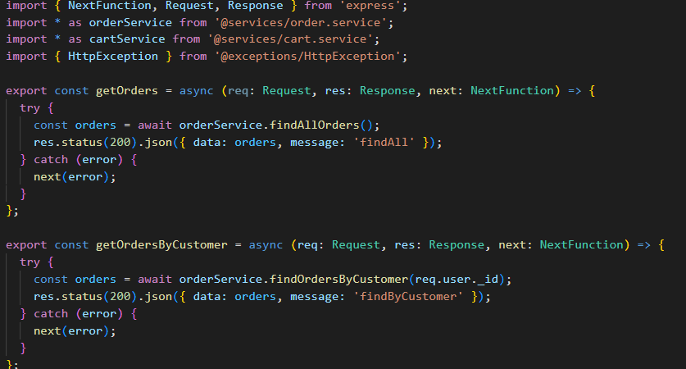
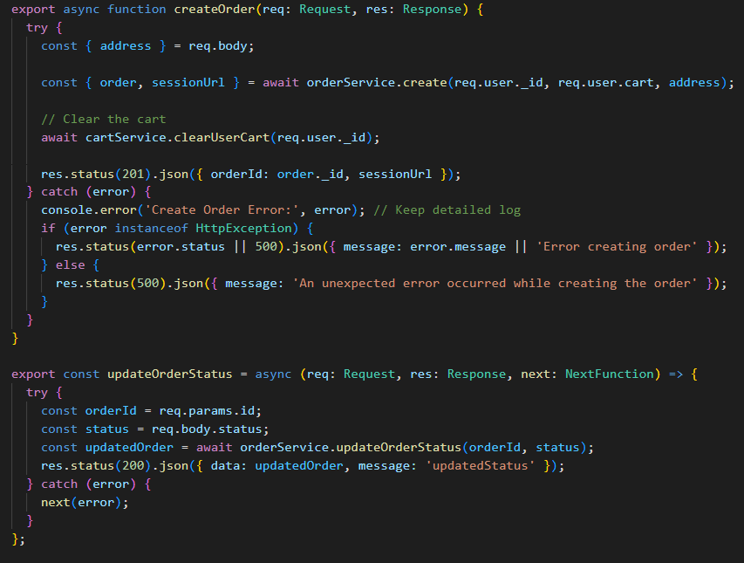
Order.controller.ts
}
...
Notes:
Demo / Screenshots
Optional short video/GIF walkthrough
Emphasize:
Login/Register
Product interaction
Cart & checkout
Admin product management

Slide 42
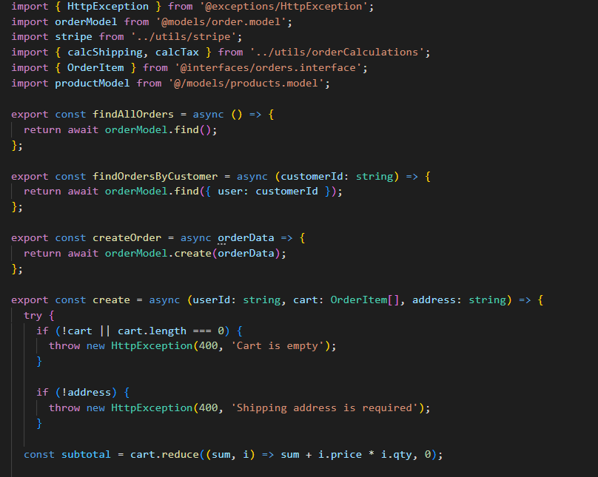
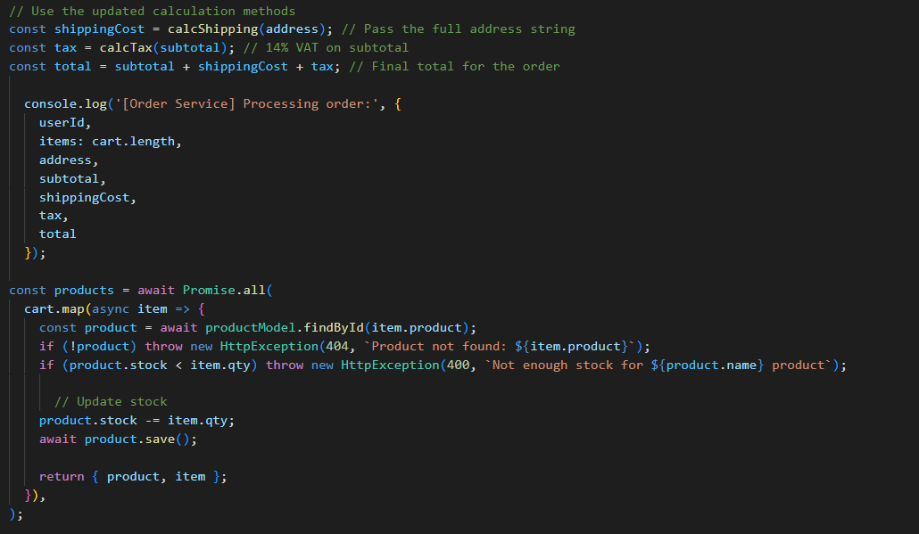
Order.service.ts
}
...
Notes:
Demo / Screenshots
Optional short video/GIF walkthrough
Emphasize:
Login/Register
Product interaction
Cart & checkout
Admin product management

Slide 43
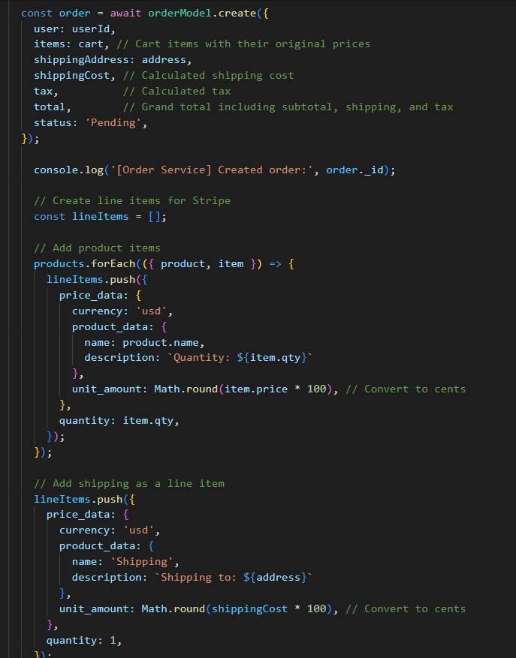
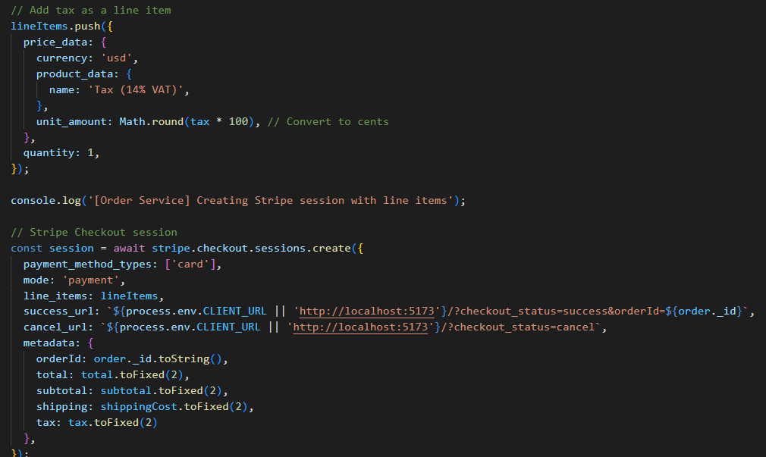
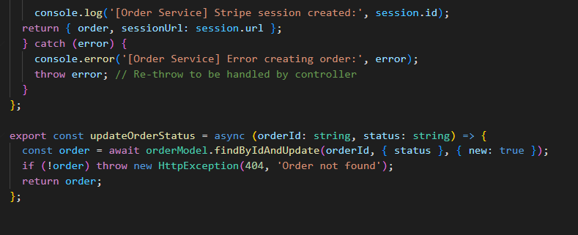
Order.service.ts
}
...
Notes:
Demo / Screenshots
Optional short video/GIF walkthrough
Emphasize:
Login/Register
Product interaction
Cart & checkout
Admin product management

Slide 44
Products
{
}
Notes:
Core Pages Walkthrough
Home Page: Product display, responsive grid
Product Page: Details, add to cart
Cart Page: Item summary + Checkout button
Checkout Page: Form + payment summary
Admin Dashboard (optional): Manage orders/products

Slide 45
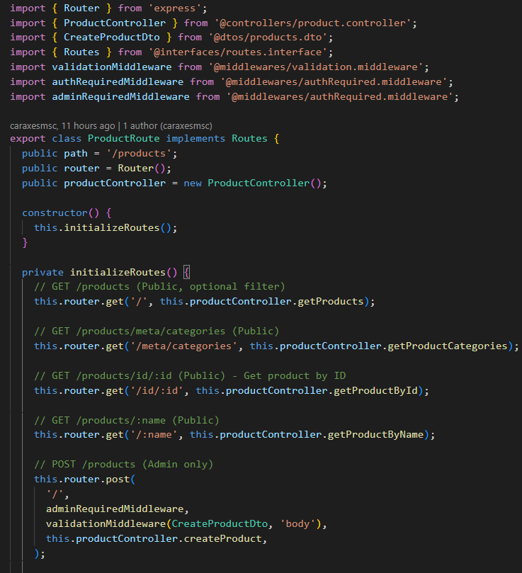
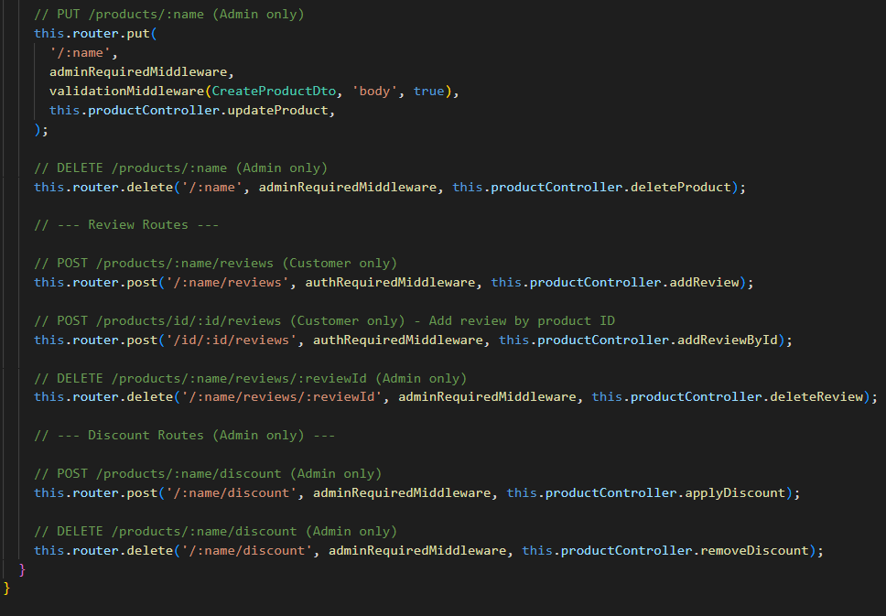
Product.route.ts
}
...
Notes:
Demo / Screenshots
Optional short video/GIF walkthrough
Emphasize:
Login/Register
Product interaction
Cart & checkout
Admin product management

Slide 46
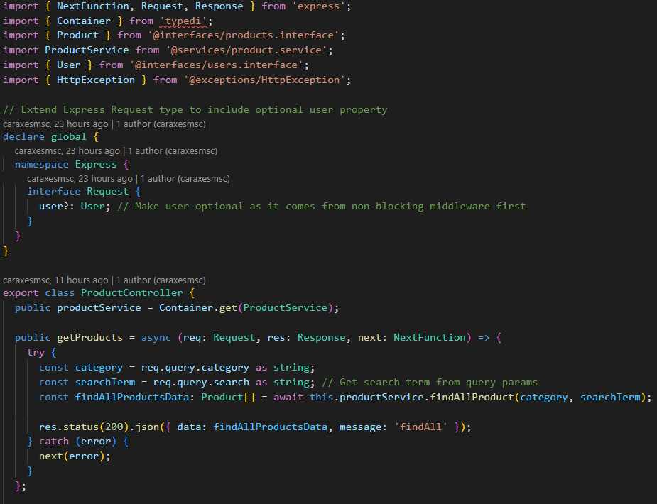
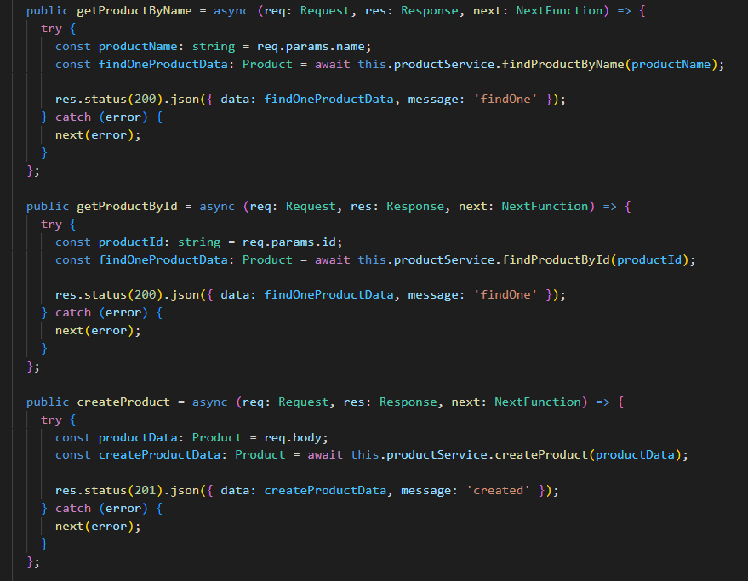
Product.controller.ts
}
...
Notes:
Demo / Screenshots
Optional short video/GIF walkthrough
Emphasize:
Login/Register
Product interaction
Cart & checkout
Admin product management

Slide 47
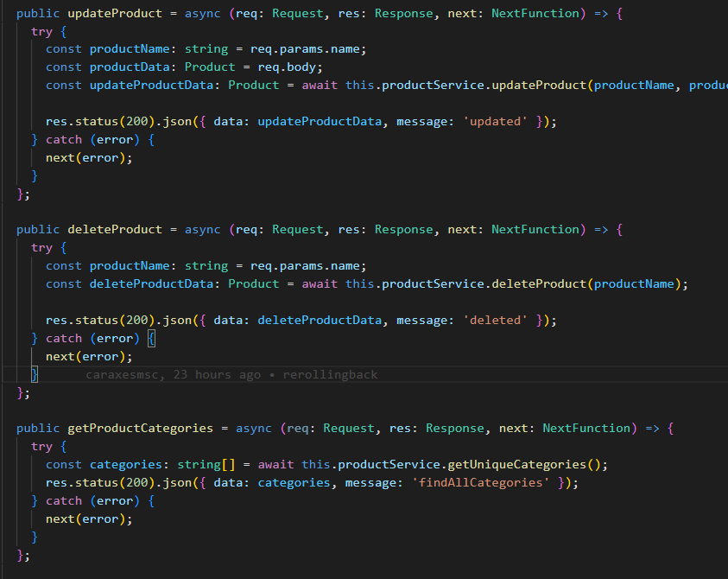
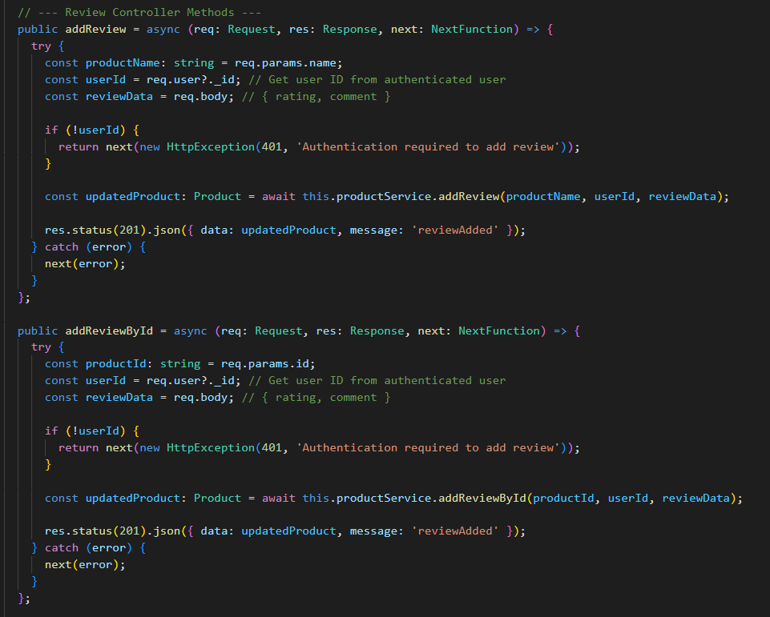
Product.controller.ts
}
...
Notes:
Demo / Screenshots
Optional short video/GIF walkthrough
Emphasize:
Login/Register
Product interaction
Cart & checkout
Admin product management

Slide 48
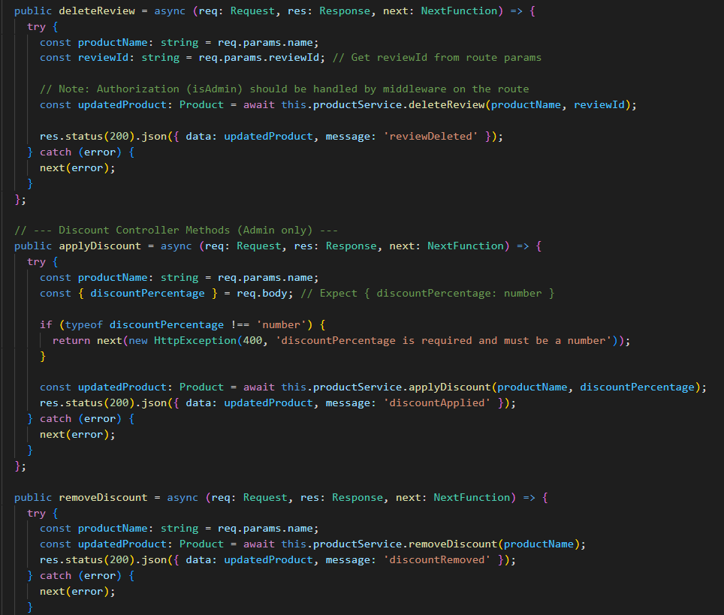
Product.controller.ts
}
...
Notes:
Demo / Screenshots
Optional short video/GIF walkthrough
Emphasize:
Login/Register
Product interaction
Cart & checkout
Admin product management

Slide 49
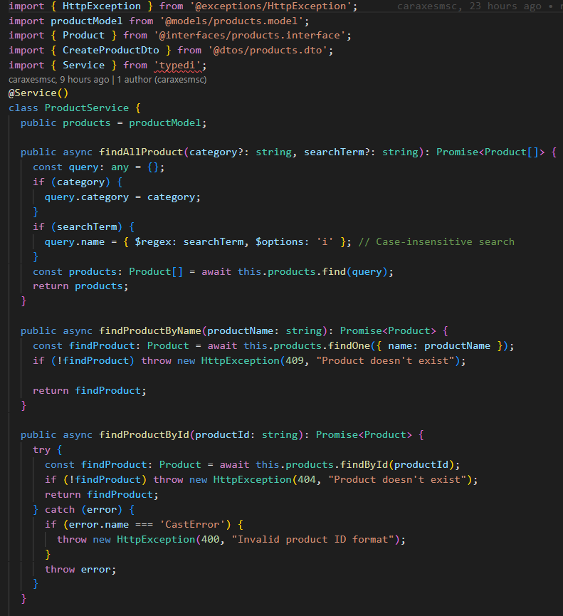
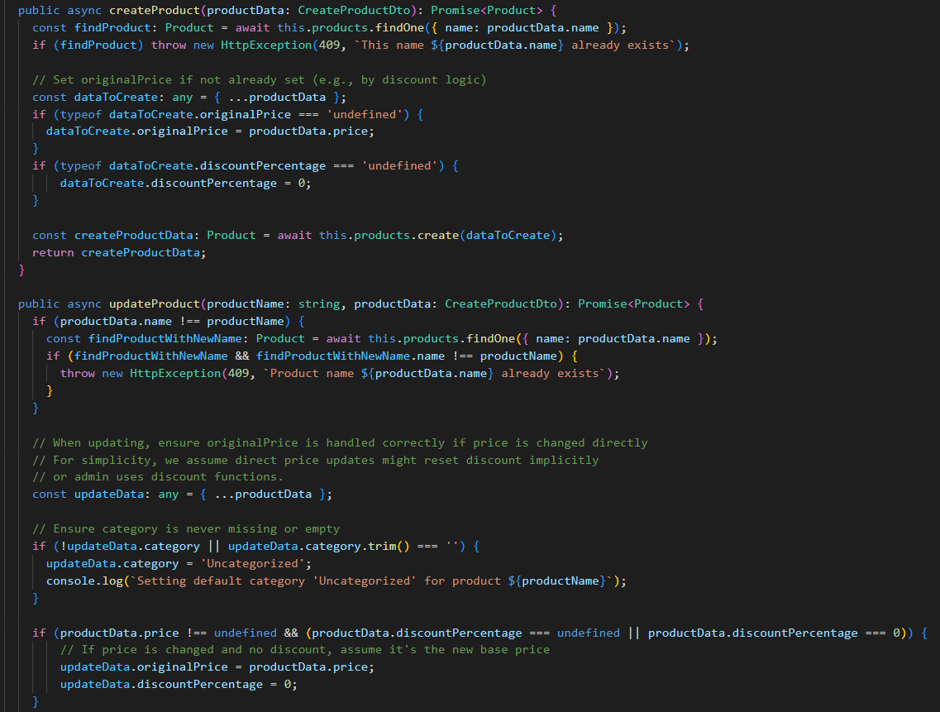
Product.service.ts
}
...
Notes:
Demo / Screenshots
Optional short video/GIF walkthrough
Emphasize:
Login/Register
Product interaction
Cart & checkout
Admin product management

Slide 50
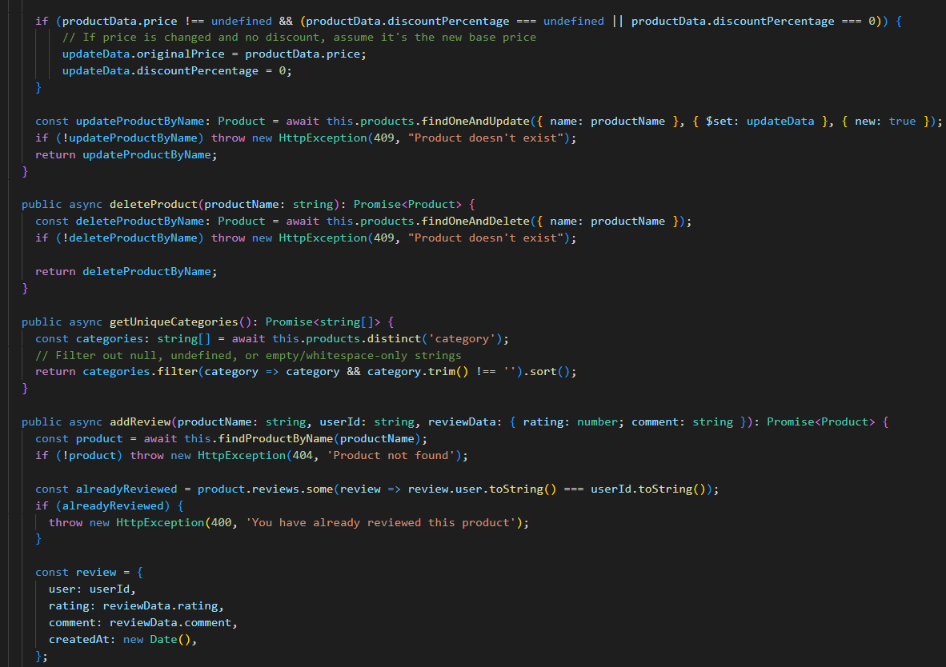
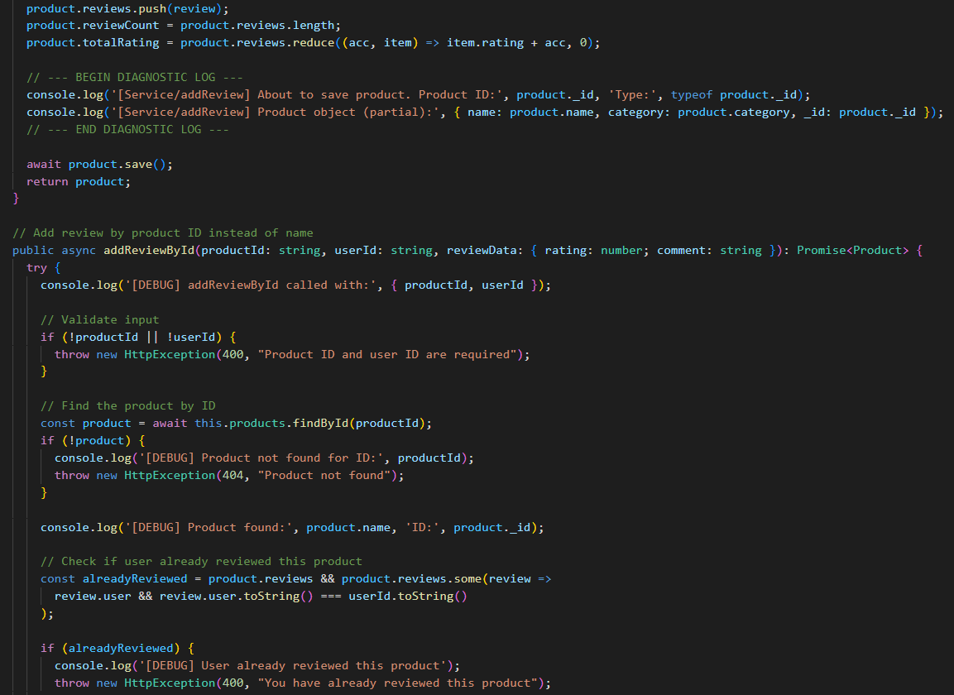
Product.service.ts
}
...
Notes:
Demo / Screenshots
Optional short video/GIF walkthrough
Emphasize:
Login/Register
Product interaction
Cart & checkout
Admin product management

Slide 51
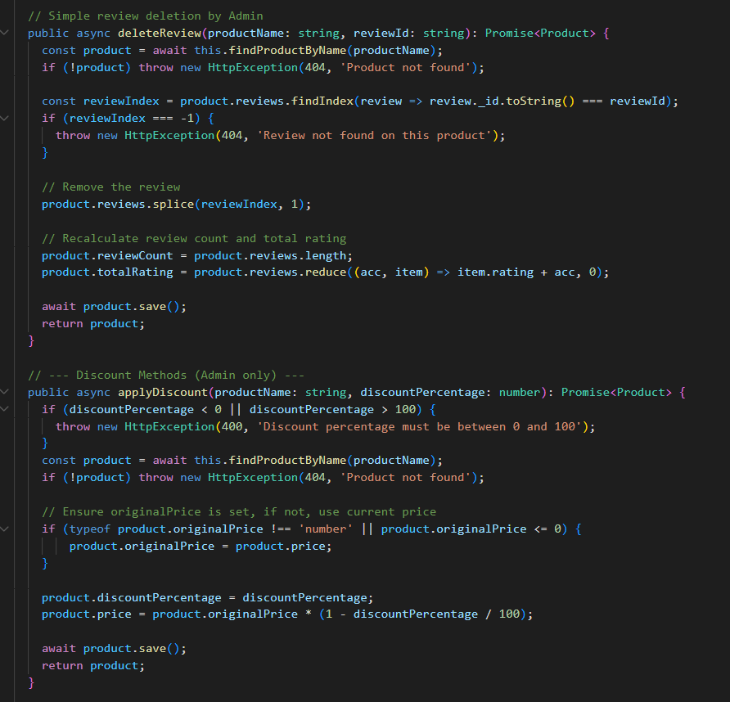
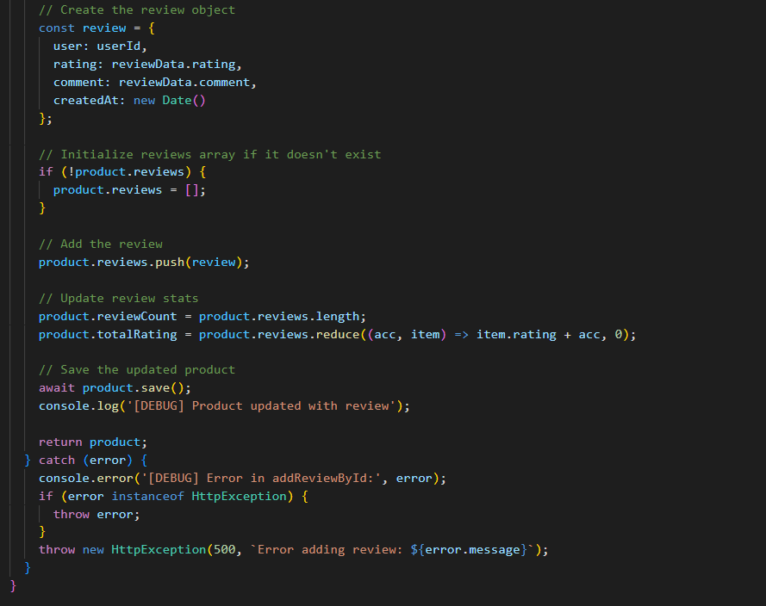
Product.service.ts
}
...
Notes:
Demo / Screenshots
Optional short video/GIF walkthrough
Emphasize:
Login/Register
Product interaction
Cart & checkout
Admin product management

Slide 52
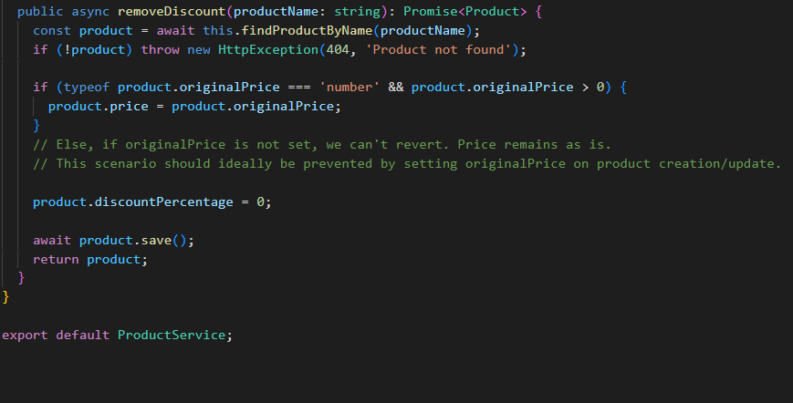
Product.service.ts
}
...
Notes:
Demo / Screenshots
Optional short video/GIF walkthrough
Emphasize:
Login/Register
Product interaction
Cart & checkout
Admin product management

Slide 53
Reviews
{
}
Notes:
Core Pages Walkthrough
Home Page: Product display, responsive grid
Product Page: Details, add to cart
Cart Page: Item summary + Checkout button
Checkout Page: Form + payment summary
Admin Dashboard (optional): Manage orders/products

Slide 54
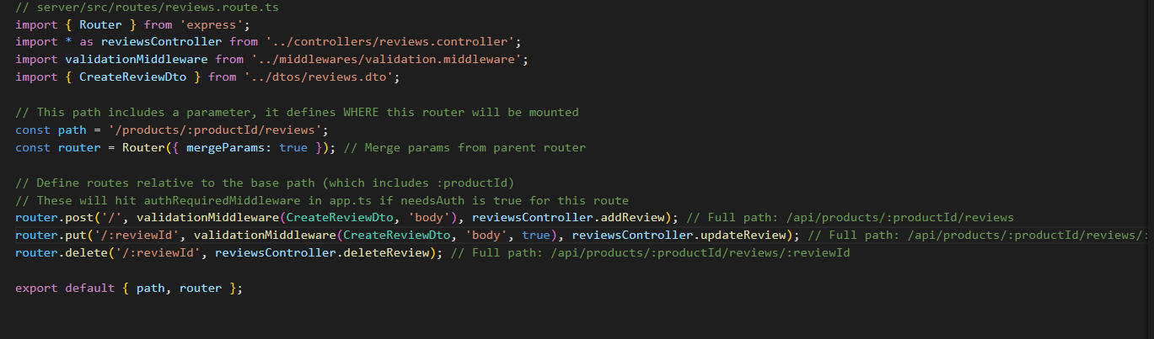
Reviews.route.ts
}
...
Notes:
Demo / Screenshots
Optional short video/GIF walkthrough
Emphasize:
Login/Register
Product interaction
Cart & checkout
Admin product management

Slide 55
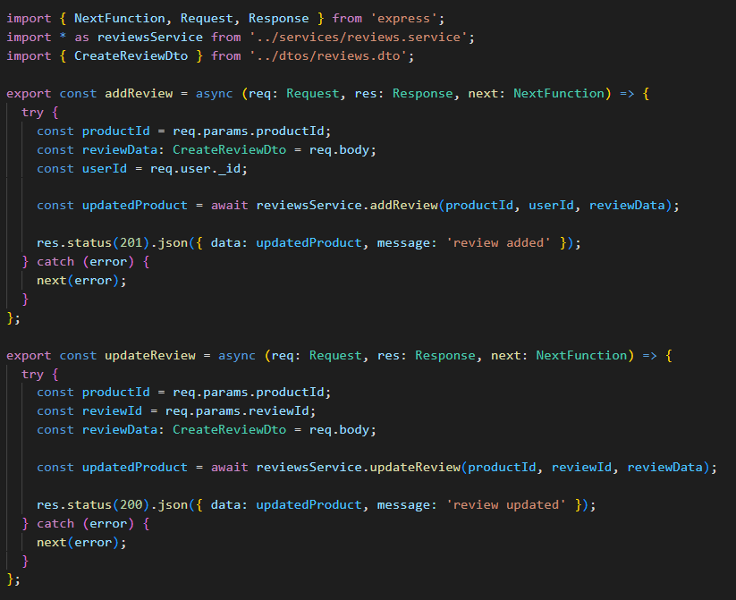
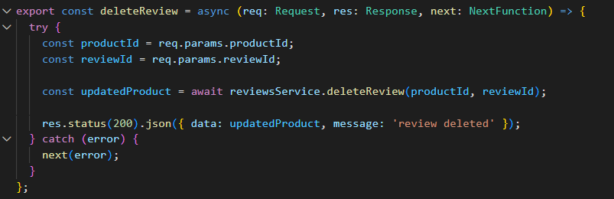
Reviews.controller.ts
}
...
Notes:
Demo / Screenshots
Optional short video/GIF walkthrough
Emphasize:
Login/Register
Product interaction
Cart & checkout
Admin product management

Slide 56
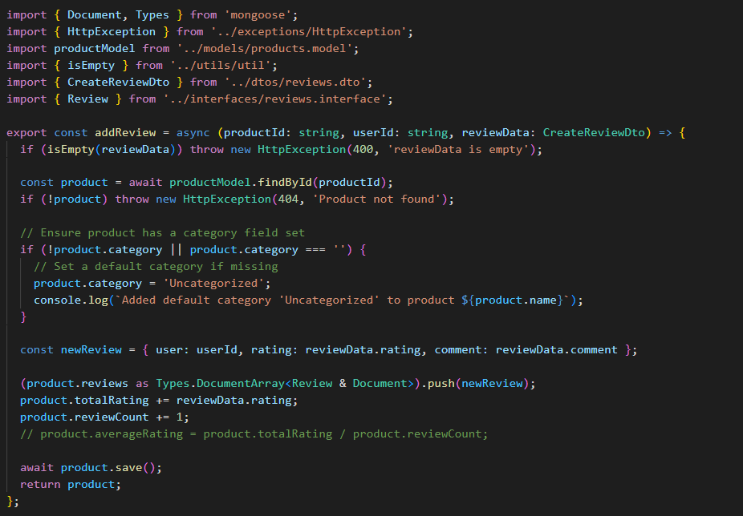
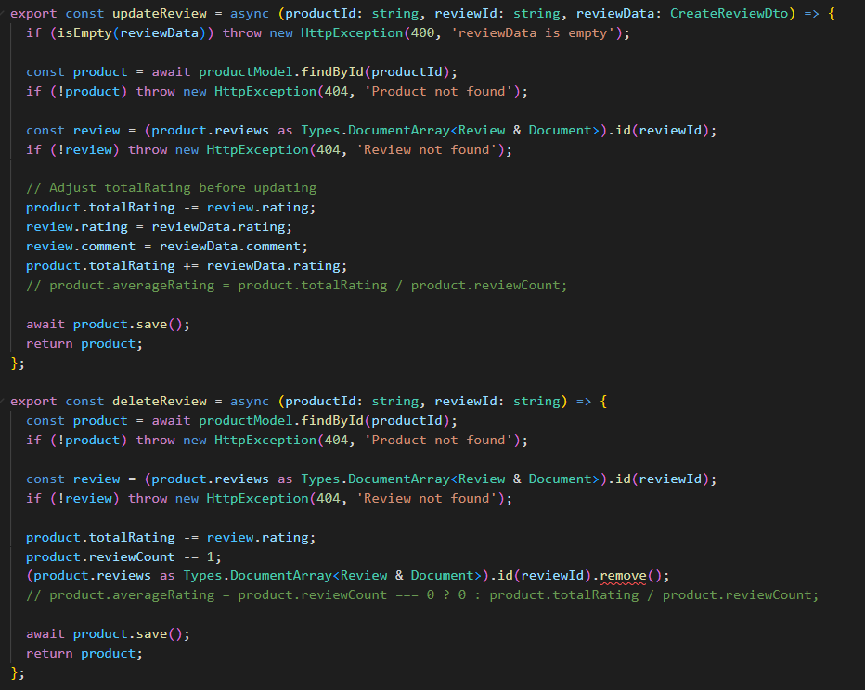
Reviews.service.ts
}
...
Notes:
Demo / Screenshots
Optional short video/GIF walkthrough
Emphasize:
Login/Register
Product interaction
Cart & checkout
Admin product management

Slide 57
Users
{
}
Notes:
Core Pages Walkthrough
Home Page: Product display, responsive grid
Product Page: Details, add to cart
Cart Page: Item summary + Checkout button
Checkout Page: Form + payment summary
Admin Dashboard (optional): Manage orders/products

Slide 58
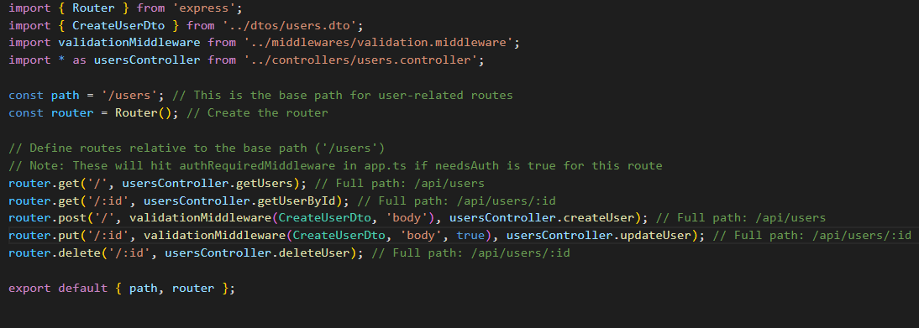
Users.route.ts
}
...
Notes:
Demo / Screenshots
Optional short video/GIF walkthrough
Emphasize:
Login/Register
Product interaction
Cart & checkout
Admin product management

Slide 59
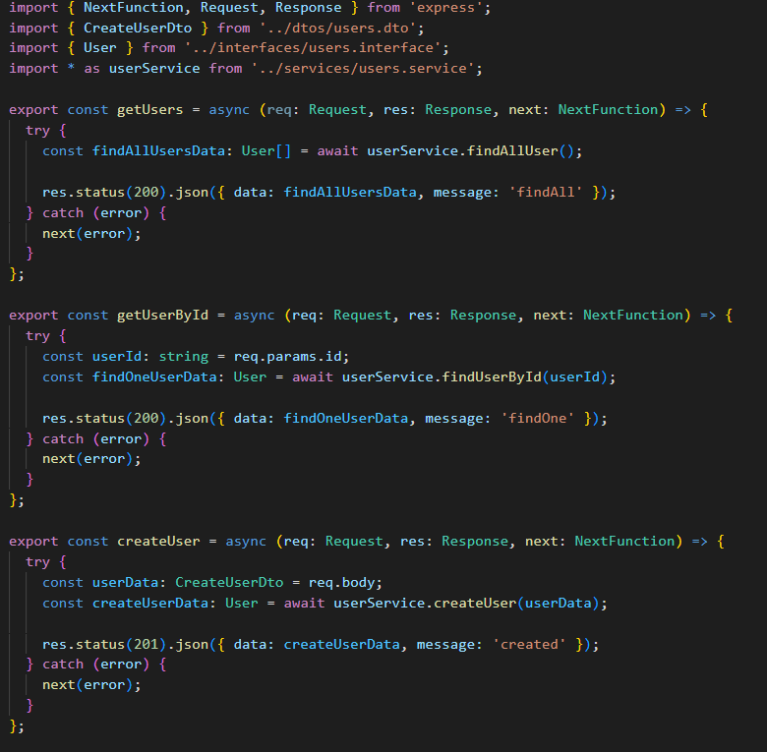
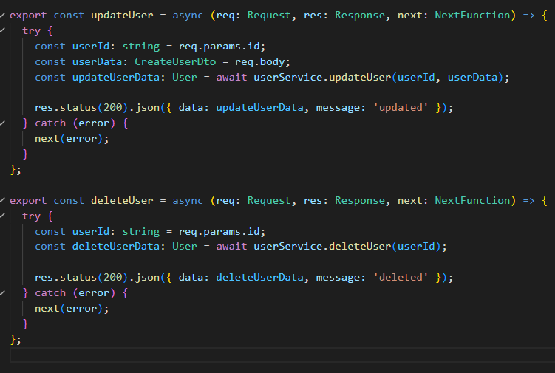
Users.controller.ts
}
...
Notes:
Demo / Screenshots
Optional short video/GIF walkthrough
Emphasize:
Login/Register
Product interaction
Cart & checkout
Admin product management

Slide 60
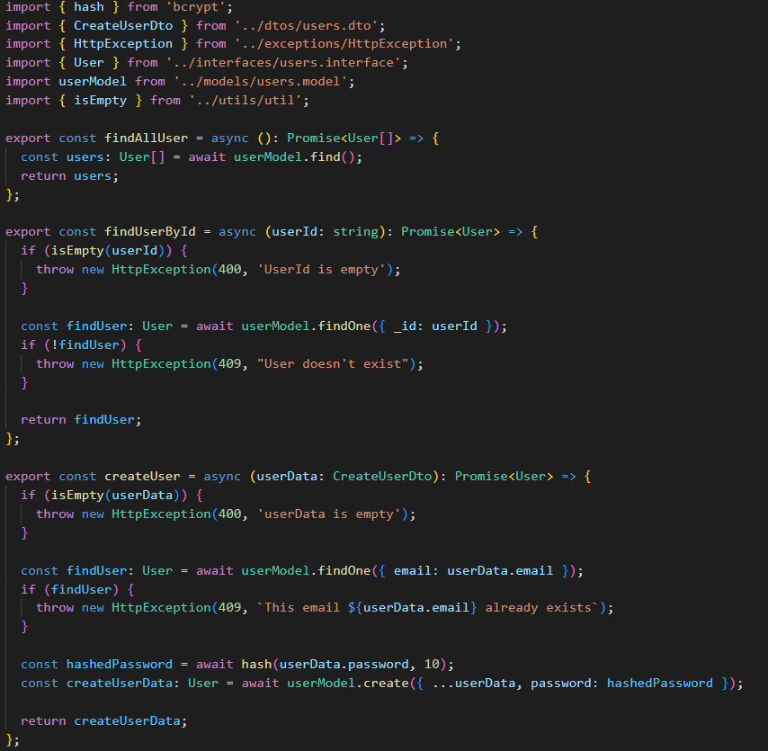

Users.service.ts
}
...
Notes:
Demo / Screenshots
Optional short video/GIF walkthrough
Emphasize:
Login/Register
Product interaction
Cart & checkout
Admin product management

Slide 61

Users.service.ts
}
...
Notes:
Demo / Screenshots
Optional short video/GIF walkthrough
Emphasize:
Login/Register
Product interaction
Cart & checkout
Admin product management

Slide 62




Process Screenshots
{
*
..
popup
Login and register
Profile edit
Notes:
Frontend-Backend Integration
API integration for login, product fetch, cart sync
Token storage (localStorage or cookies)
Error handling and user feedback (toasts, alerts)

Slide 63



Process Screenshots
{
*
..
Products page
Add items to cart from product page
Add item to cart from product details page and write a review
Notes:
Frontend-Backend Integration
API integration for login, product fetch, cart sync
Token storage (localStorage or cookies)
Error handling and user feedback (toasts, alerts)

Slide 64


Process Screenshots
{
*
..
Filtering for books
Search for chipsy
Notes:
Frontend-Backend Integration
API integration for login, product fetch, cart sync
Token storage (localStorage or cookies)
Error handling and user feedback (toasts, alerts)

Slide 65



Process Screenshots
{
*
..
Review added
My cart with subtotal
My checkout with shipping default at $75 and taxes at 14% when i write my address it will change
Notes:
Frontend-Backend Integration
API integration for login, product fetch, cart sync
Token storage (localStorage or cookies)
Error handling and user feedback (toasts, alerts)

Slide 66




Process Screenshots
{
*
..
When i added cairo it changed the shipping to 50
Opens the payment gateway
(not my actual card)
Payment success will auto redirect to my order history
Notes:
Frontend-Backend Integration
API integration for login, product fetch, cart sync
Token storage (localStorage or cookies)
Error handling and user feedback (toasts, alerts)

Slide 67






Process Screenshots
{
*
..
Admin user part
Admin product part
Different status denote the order status the last one in the list is the one we did now
Notes:
Frontend-Backend Integration
API integration for login, product fetch, cart sync
Token storage (localStorage or cookies)
Error handling and user feedback (toasts, alerts)

Slide 68



Process Screenshots
{
*
..
Adding new product
Editing product
Discount
Notes:
Frontend-Backend Integration
API integration for login, product fetch, cart sync
Token storage (localStorage or cookies)
Error handling and user feedback (toasts, alerts)

Slide 69

Process Screenshots
{
*
..
Managing orders
Notes:
Frontend-Backend Integration
API integration for login, product fetch, cart sync
Token storage (localStorage or cookies)
Error handling and user feedback (toasts, alerts)

Slide 70

Computer mockup
{
It looks good on desktop
}
...
Notes:
Responsive Design & UX

Slide 71

Phone mockup
{
And on mobile too
}
...

Slide 72
Thank
you
}
< we appreciate your efforts and great teachings />
*

